Slide 1




Submitted to,
Venkataramana Sir
COLLEGE MANAGEMENT SYSTEM
Prepared by,
Rajesh-2200520041
Vamsi-2200520042
Rohith-2200520093

Slide 2

Brief:
A college management system is an online software designed to help colleges and higher education institutes to manage their day to day activities efficiently. An ideal college management system should enable institutes to manage all of their activities - from admission to report cards online without any hassle.
It is a cloud based software with which educators, students and parents can collaborate on a single platform and improve their efficiency and performance.

Slide 3

Features:
1. Efficient Accounting Mechanism:
Finance is one of the basic and vital parts of colleges and universities because it deals with money.
2. Ability To Manage Staffs Effectively:
Unlike elementary schools, universities and colleges usually have a high number of staffs. Managing such a multitude is difficult without the aid of this university management software. Using this college erp software helps to keep track of all staffs salaries, general well-being, the rate at which they attend class and many more.
3. Accurate Entrance Test & Merit Lists:
Right here is another feature that makes things far easier than you could imagine. The admission process of colleges is usually cumbersome due to a large number of applicants.
4. Timetable Generation:
Fixing classes is no doubt one the messiest thing to organize in colleges due to a large number of classes that are to hold on a daily basis and the lecturers to take them. Determining this without any error can be quite difficult.
5. General Library Management:
Managing the library is another complicated section in colleges. But with the help of this university management software, librarians and other staffs in the library are able to keep track of all the materials that go in and out of the library with ease.

Slide 4

Benefits:
A college management system allows colleges and higher education institutes to manage their enquiries and leads, carry out online admissions, teach virtually, sell courses, track student progress, take exams and quizzes, manage attendance, take assignments online, manage learning material, generate report cards, create ID cards and documents, send notices and announcements, manage communications, manage timetables, manage results online.

Slide 5

CODE FOR COLLEGE MANAGEMENT SYSTEM
When you run the program, it will output the student's name, roll number, and the courses they are enrolled in.
This is a simplified example, and in a real college management system, you would have more classes and features to handle various aspects like faculty management, exam management, financial transactions, and more. But this example should give you a basic understanding of how a college management system can be implemented in Java.

Slide 6

import java.util.ArrayList;
import java.util.Scanner;
class Student
{
private int rollNumber;
private String name;
private int age;
public Student(int rollNumber, String name, int age)
{
this.rollNumber = rollNumber;
this.name = name;
this.age = age;
}
public int getRollNumber()
{ return rollNumber;
}
public String getName()
{
return name;
}
public int getAge()
{ return age;
}
}
Student Class

Slide 7

class CollegeManagementSystem { private ArrayList<Student> students; public CollegeManagementSystem() { students = new ArrayList<>(); } public void addStudent(Student student) { students.add(student); } public void displayStudents() { if (students.isEmpty()) { System.out.println("No students found."); } else { System.out.println("Student List:"); for (Student student : students) { System.out.println("Roll Number: " + student.getRollNumber()); System.out.println("Name: " + student.getName()); System.out.println("Age: " + student.getAge()); System.out.println("------------------------"); } } } public void searchStudent(int rollNumber) { boolean found = false; for (Student student : students) { if (student.getRollNumber() == rollNumber) { System.out.println("Roll Number: " + student.getRollNumber()); System.out.println("Name: " + student.getName()); System.out.println("Age: " + student.getAge()); found = true; break; } } if (!found) { System.out.println("Student with roll number " + rollNumber + " not found."); } } }
Class College Management System

Slide 8

public class CollegeManagementSystemDemo { public static void main(String[] args) { Scanner scanner = new Scanner(System.in); CollegeManagementSystem cms = new CollegeManagementSystem(); while (true) { System.out.println("College Management System"); System.out.println("1. Add Student"); System.out.println("2. Display Students"); System.out.println("3. Search Student"); System.out.println("4. Quit"); System.out.print("Enter your choice: "); int choice = scanner.nextInt(); switch (choice) { case 1: System.out.print("Enter Roll Number: "); int rollNumber = scanner.nextInt(); scanner.nextLine(); // Consume the newline character System.out.print("Enter Name: "); String name = scanner.nextLine(); System.out.print("Enter Age: "); int age = scanner.nextInt(); Student student = new Student(rollNumber, name, age); cms.addStudent(student); System.out.println("Student added successfully!"); break; case 2: cms.displayStudents(); break; case 3: System.out.print("Enter Roll Number: "); int searchRollNumber = scanner.nextInt(); cms.searchStudent(searchRollNumber); break; case 4: System.out.println("Thank you for using the College Management System."); System.exit(0); default: System.out.println("Invalid choice. Please try again."); } System.out.println(); } } }
Main class for College Management System

Slide 9

Methods | Variables | DataTypes | Keywords | Identifiers
Student(int rollNumber, String name, int age) | rollNumber | integer | Public | Class names
getRollNumber() | name | float | Private | Method names
getName() | age | double | Protected | Variable names
getAge() | Search toll number | boolean | Static | Constant names
CollegeManagementSystem() | email | char | Void | Package names
addStudent(Student student) | courses | Arrays | If/else | Interface names
displayStudents() | grades | lists | For/while | choice
searchStudent(int rollNumber) | registration date | objects | Switch/case
addCourse() | fee structure | String | extends
viewStudentDetails() | academic year | Date | Implements

Slide 10

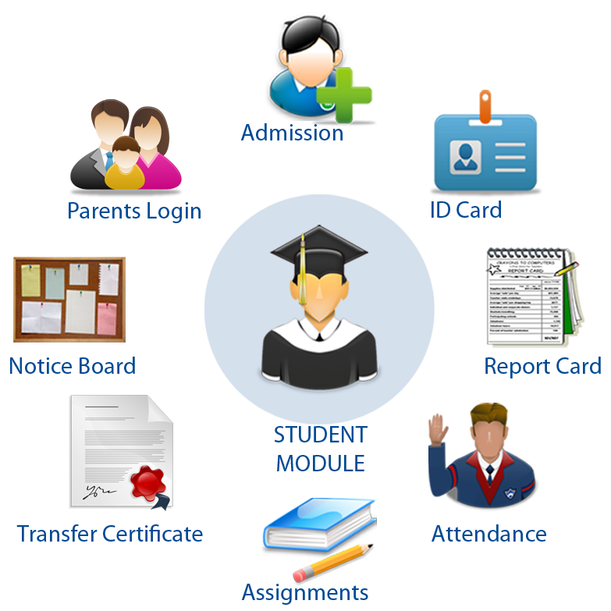
College Management System
1. Add Student
2. Display Students
3. Search Student
4. Quit
Enter your choice: 1
Enter Roll Number: 101
Enter Name: John Doe
Enter Age: 20
Student added successfully!
College Management System
1. Add Student
2. Display Students
3. Search Student
4. Quit
Enter your choice: 1
Enter Roll Number: 102
Enter Name: Jane Smith
Enter Age: 21
Student added successfully!
College Management System
1. Add Student
2. Display Students
3. Search Student
4. Quit
Enter your choice: 2
Student List:
Roll Number: 101
Name: John Doe
Age: 20
------------------------
Roll Number: 102
Name: Jane Smith
Age: 21
------------------------
OUTPUT:
College Management System
1. Add Student
2. Display Students
3. Search Student
4. Quit
Enter your choice: 3
Enter Roll Number: 102
Roll Number: 102
Name: Jane Smith
Age: 21
College Management System
1. Add Student
2. Display Students
3. Search Student
4. Quit
Enter your choice: 3
Enter Roll Number: 103
Student with roll number 103 not found.
College Management System
1. Add Student
2. Display Students
3. Search Student
4. Quit
Enter your choice: 4
Thank you for using the College Management System.

Slide 11

Abstract classes in college management
System
Abstract Class:
An abstract class serves as a blueprint for other classes and can provide common implementation and attributes. It allows you to define methods that must be implemented by subclasses and also provides the flexibility to include non-abstract methods with default implementations.
By using an abstract class, you can define a common interface for different types of individuals in the college management system. This allows you to ensure that each concrete subclass provides an implementation for the required methods.

Slide 12

Interface Classes
in College management
System
Interface:
An interface defines a contract that classes must adhere to by implementing its methods. It allows classes to provide multiple inheritance of behavior through interfaces and promotes loose coupling between classes.
Using interfaces in Java allows you to define a common contract that classes can adhere to. It helps enforce consistency and provides a way to interact with objects of different types through a shared interface.

Slide 13

Package in college Management System
Package:
In Java, a package is a mechanism for organizing and grouping related classes, interfaces, and other resources. It provides a way to manage and control the visibility and accessibility of classes and resources within a project or application.
By using packages, we can organize related classes into separate namespaces and promote code modularity and reusability in the college management system.

Slide 14


Slide 15


